Slide 1

The Globox Homepage Revamp
A Data-Driven Analysis
By Ruchika Tiwari

Slide 2
GloBox - An E-commerce Company
Specializes in unique, high-quality products from around the world.
Believes shopping should be an adventure.
Curates a selection of exclusive products.
Known for boutique fashion and high-end decor.

Slide 3
Expanding Food and Drink Offerings for Revenue Growth
GloBox’s food and drink offerings have grown tremendously in the last few months.
The company wants to bring awareness to this product category to increase revenue.

Slide 4
Globox’s Current Objective
Directing our spotlight to culinary and beverage options.
Goal: increase revenue and awareness of this product category.

Slide 5
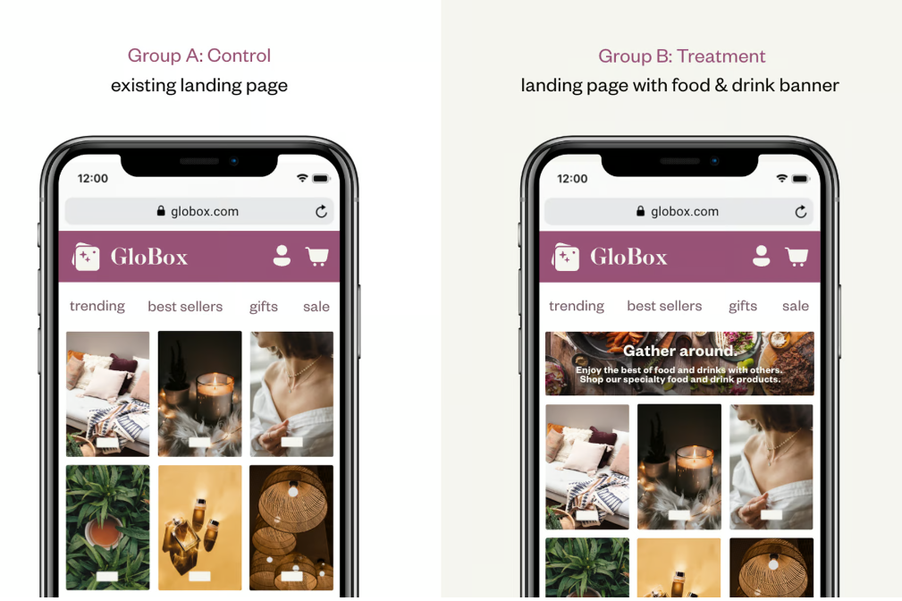
A/B Testing
GloBox runs an A/B test, comparing a webpage with and without a food and drink banner.
Control group does not see the banner, and the test group sees it as shown below
With an objective to determine which version performs better.
Notes:
Control Group A: does not see the banner
Treatment Group B: Sees the banner

Slide 6
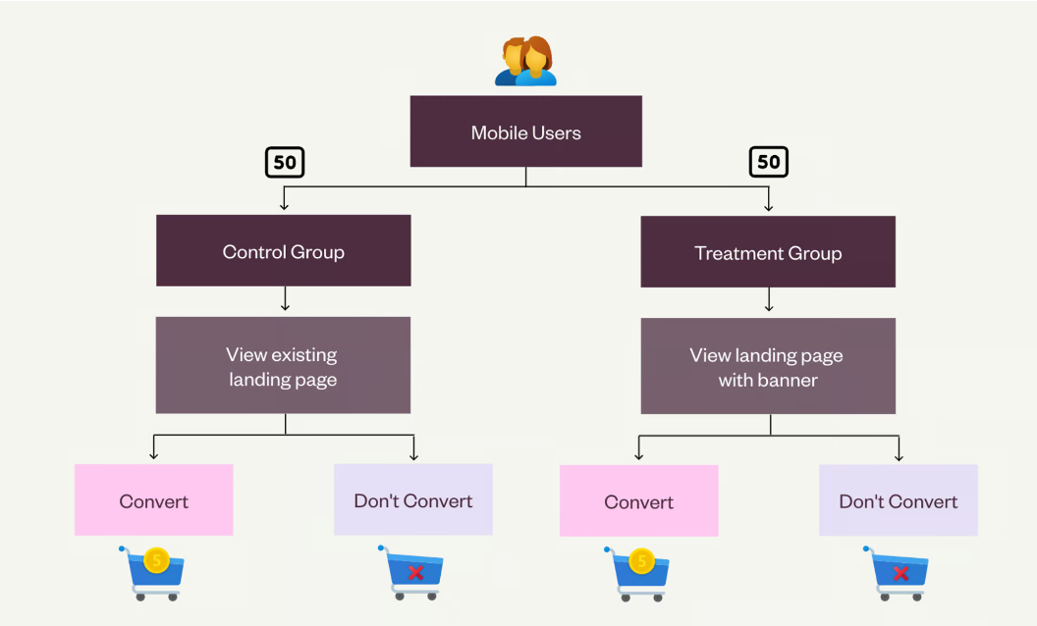
Study Design
Notes:
We used below SQL query to get the dataset for analysis: SELECT
u.id AS user_id,
u.country,
u.gender,
g.group AS test_group,
MAX(g.join_dt) AS join_date,
g.device,
SUM(a.spent) AS total_spent
FROM
users u
LEFT JOIN
groups g ON u.id = g.uid
LEFT JOIN
activity a ON u.id = a.uid
GROUP BY
u.id, u.country, u.gender, g.group, g.device

Slide 7

Questions Answered in this Study
Is there a difference in the conversion rate between the two groups?
Is there a difference in the average amount spent per user between the two groups?
Notes:
Conduct a hypothesis test to see whether there is a difference in the conversion rate between the two groups. What are the resulting p-value and conclusion?
What is the 95% confidence interval for the difference in the conversion rate between the treatment and control (treatment-control)?
Conduct a hypothesis test to see whether there is a difference in the average amount spent per user between the two groups. What are the resulting p-value and conclusion?
What is the 95% confidence interval for the difference in the average amount spent per user between the treatment and the control (treatment-control)?

Slide 8
Is There a Difference in the Conversion Rate Between the Two Groups?
 | Participants | Conversion | Conversion_rate
Group A | 24343 | 955 | 3.92
Group B | 24600 | 1139 | 4.63

Slide 9
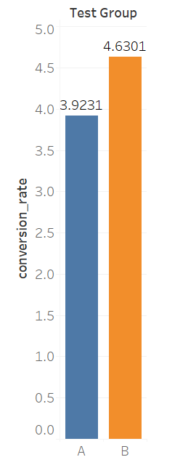
Is the Difference Meaningful?
Our statistical analysis reveals that the difference in conversion rates between the two groups is highly significant*
This means that chances of this difference occurring by random chance are extremely low
*p-value 0.00011.

Slide 10
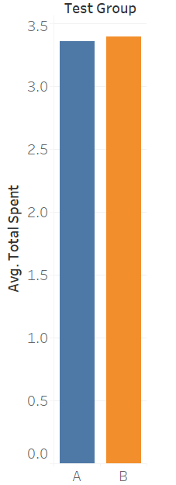
New Homepage Doesn’t Impact the Average Spending
The A/B test results indicate that there is no statistically significant* difference in the average amount spent per user between the treatment and control groups.
*p-value 0.954
Notes:
Determine the Null & alternative hypothesis
Null Hypothesis (H0): There is no significant difference in conversion rates between the two groups (test_group).
Alternative Hypothesis (H1): There is a significant difference in conversion rates between the two groups.

Slide 11
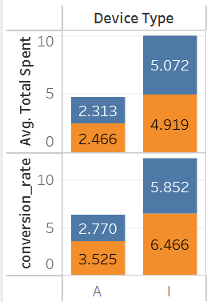

Impact of device type on conversion rate
iOS users spend more and have higher conversion rates compared to Android users.
Choice of device impacts user behavior, with iOS user showing higher engagements.

Slide 12
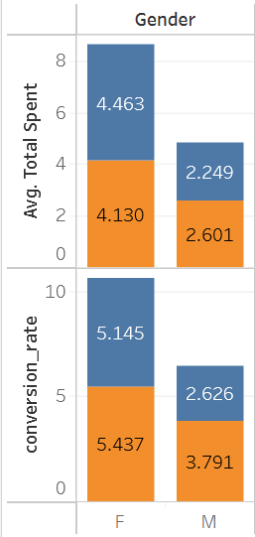

Impact of User’s Gender on Conversion
Female users spend more and have higher conversion rates compared to males.
Gender seems to consistently influences user behavior, with females exhibiting higher engagement.

Slide 13
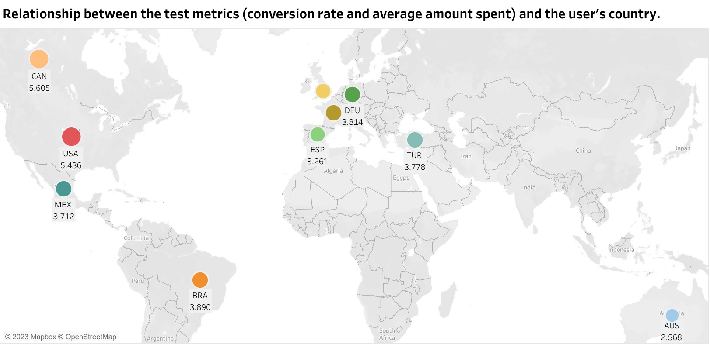
Conversion Rates by Country
Canada and the USA have the highest conversion rates.
Australia has the lowest conversion rate.
Conversion rates vary by country, indicating differences in the region.

Slide 14

Key Takeaways
The new homepage significantly improves conversion rates.
However, it doesn't significantly impact how much you spend.
Our focus should be on optimizing the new homepage to maximize conversions while monitoring the spending aspect.

Slide 15

What's Next for GloBox?
Conversion Boost: The banner significantly improved conversion rates, suggesting its installation for continued impact.
Spending Consistency: It didn't impact average spending per user.
Strategies for Improvement: Enhance user experience with personalized recommendations, improved product visibility, and compelling promotional offers.
Notes:
Based on our findings, we recommend making changes on the homepage.
While banner positively impacted conversion rates, it did not significantly affect the average amount spent per user.
Hence, focus on enhancing the user experience for food and drink shoppers, we can do this by: Personalized recommendations,
Improved product visibility,
Create compelling offers to encourage higher spending.

